Slide 1
Macroecology & Biogeography 1
Latitudinal Gradients in Biodiversity
Group 5

Slide 2
What is Macroecology & Biogeography?
hub Macroecology
public Biogeography
Study of the relationships of organisms among each other and with their environment at large spatial, temporal, or taxonomic scales.
Study of the distribution of living organisms across different habitats and regions of the Earth and the factors influencing that distribution over time.
Sources: EBSCO (5) & German Centre for Integrative Biodiversity Research (7)

Slide 3
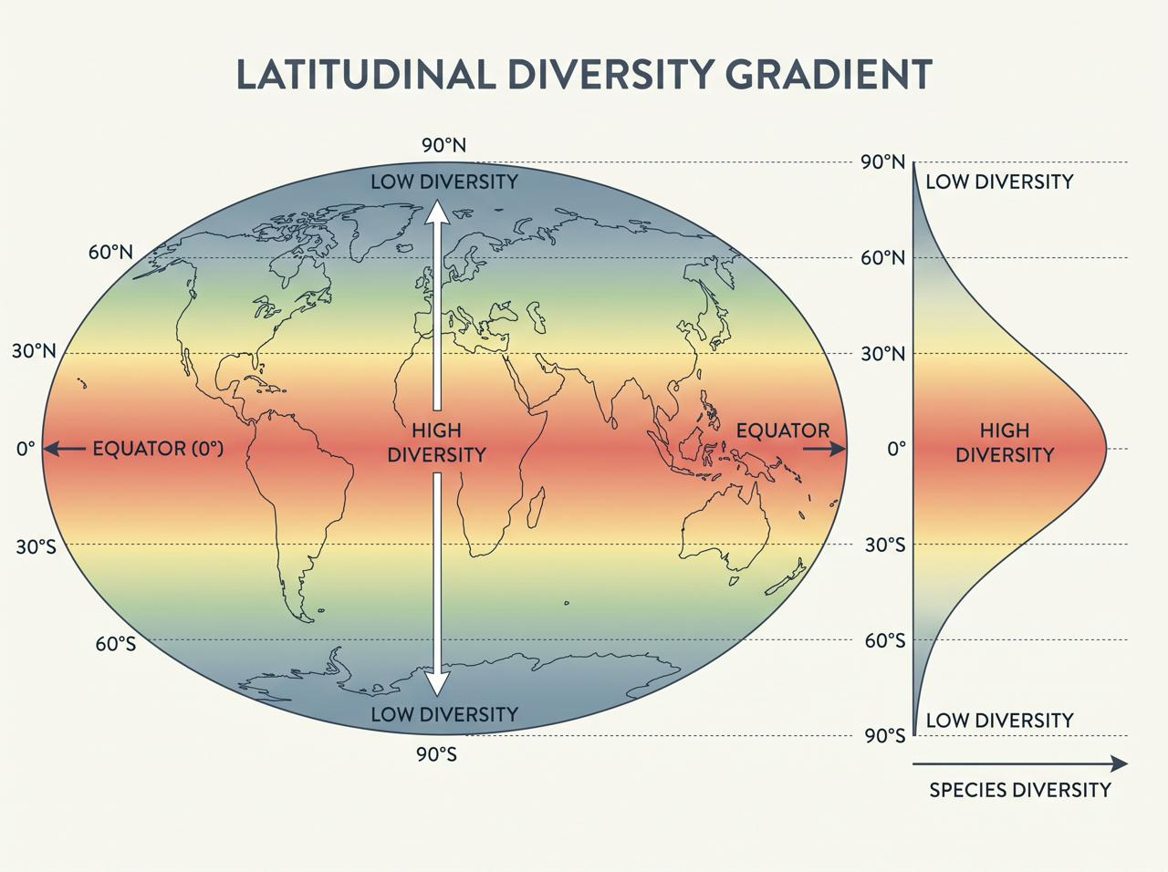
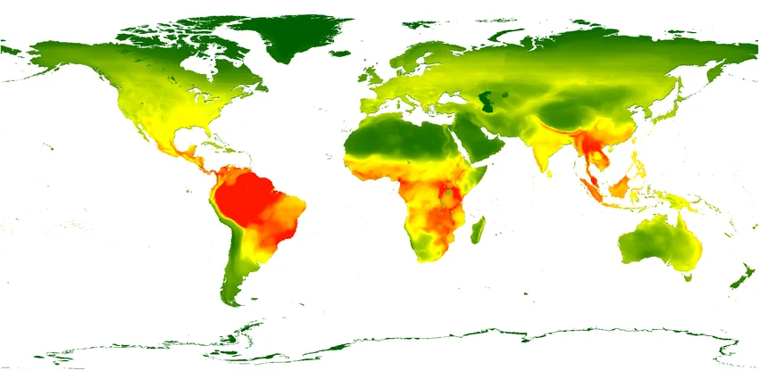
What is LDG?
Created with Gemini Notebook
Image: Research Gate
Sources: Brodie (2), Willig (14)
Notes:
The Latitudinal Diversity Gradient, or LDG, is a general pattern in which biodiversity, especially species richness, is highest near the equator and generally decreases toward the North and South Poles.
The pattern was observed by von Humboldt in the 19th century and later recognized by scientists like Darwin and Wallace.
In the first picture you can see a scheme of this pattern. Tropical regions, such as the Amazon rainforest and parts of Central Africa and Southeast Asia, have particularly high species richness. In contrast, polar regions generally have fewer species. This pattern has been observed in many groups of organisms, including plants, mammals, birds and marine organisms across multiple continents.
But in the second picture you can see that there are exceptions to this pattern - like in North Africa (where the sahara desert is) and in Asia on the Arabian peninsula and also in central Asia.
Willig et al. define the classical pattern on the Latitudinal diversity gradient as negative association between species richness, so the amount of different species in an area, and latitude meaning as latitude increases, biodiversity decreases.

Slide 4
Guiding Question
Why does biodiversity peak in the tropics and fall toward the poles, and does that hold for every dimension?
DIMENSIONS OF DIVERSITY
Functional
Counting jobs
Phylogenetic
Measure historic relationships
Taxonomic
Counting species
SPATIAL SCALES
…
α
β
γ
Point Diversity
Single sample point
Alpha Diversity
In one community
Beta Diversity
Difference communities
Gamma Diversity
In multiple communities
Sources: Chao (3)(4), Willig (14)
Notes:
Biodiversity is more than just the number of species.There are many different ways of looking at biodiversity.
Biodiversity dimensions:
Taxonomic - “counting species” → How many different species are there?
Functional - “counting jobs” → What do these organisms do? We’re looking at present ecological traits and functions, like pollination, decomposition, predation, seed dispersal etc. The more, the higher the diversity.
Phylogenetic - “measure historic relationships” → how evolutionary different are the organisms or how closely related are the species in specific ecosystems. Diversity of evolutionary relationships.
This means, a habitat with fewer species can still be highly biodiverse if those species have very different functions and evolutionary histories. Biodiversity is more complicated than simply counting species.
Spatial Scales:
Point Diversity: Diversity at a single, small sampling point
Alpha Diversity: Diversity looking at an entire community
Beta Diversity: How does species composition change between measuring points (time/space)?
Gamma Diversity: Diversity looking at several communities

Slide 5
Methodological Challenges
map
filter_alt
speed
PROBLEM 01
Defining area
PROBLEM 02
Sampling effort
PROBLEM 03
Evolutionary rates
Sources: Brodie (2), Chao (3)
Notes:
Because there are so many ways to define diversity, measuring LDG becomes difficult to quantify. Ecologists struggle with whether to measure "area" as the total surface area of a zone like total tropical landmass, or the latitudinal area so the north-south span of a species or ecosystem which gets narrower at higher latitudes(older article explains). Another issue scientists face is discrepancy in sampling efforts. Biodiversity sampling is more heavily concentrated in wealthy, temperate regions and the tropics are so diverse with species we have limited information on or the area is so remote, we have limited information about it. This is especially the case with marine biodiversity. The third major issue is evolutionary rates. Counting species today doesn't tell us how they got there. We cannot easily see if the tropics have more species because new ones are born faster (a cradle), or because old ones live longer without dying out (a museum).

Slide 6
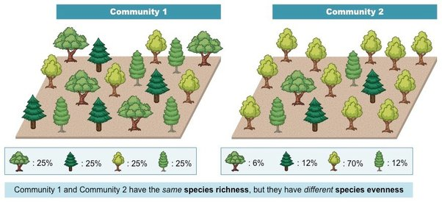
Methods of Measurement
format_list_bulleted Species Richness
ILLUSTRATING RICHNESS VS. EVENNESS
schema Higher Taxonomic Groups
equalizer Species Evenness
Image Source: bioninja.com
Sources: Brodie (2), Chao (3), Nature Index (9)
Notes:
So then, how do ecologists measure LDG? The main metric measured is species richness. This is calculated by counting the total number of species in a given area which can be a large task. Researchers sometimes count higher taxonomic groups, such as the total number of genera (plural of genus) or families in an area. This helps because missing a rare species is common but missing an entire genus is not. It also unlocks the fossil record where exact species are hard to identify, and proves the gradient is an ancient, deep-time evolutionary pattern rather than a temporary example. Evenness measures how equally individuals are distributed among those species. Unlike species richness, species evenness does not follow a predictable pattern from the equator to the poles and is often completely separated from the latitudinal gradient. In fact, tropical ecosystems can sometimes have lower evenness because they are dominated by a few highly abundant species along with many rare ones when there is so much diversity.

Slide 7
Why does LDG occur?
No single explanation: several interacting factors shape the pattern.
CLIMATE & ENERGY
HABITAT AREA
EVOLUTIONARY HISTORY
BIOTIC FACTORS
Main driver
More area → more niches
Lineages over time
Local filtering
Sunlight, temperature,
precipitation, seasonality
Greater habitat variety
can support more species
Speciation and extinction
shape regional diversity
Competition, predation
and pollination
Order of Priority
1. Climate & Energy (Main Driver) → 2. Habitat Area → 3. Evolutionary History → 4. Biotic Factors
Sources: Brodie (2), Mittelbach (10), Willig (14)
Notes:
There is no single clear explanation. Instead, the pattern is shaped by a complex combination of interacting abiotic and biotic factors.
Among all of these, climate is the main overarching factor, influenced by amount of sunlight, average temperatures, precipitation, and seasonality.
We can see its impact clearly across geological time. During cooler periods, like our current climate, biodiversity peaks sharply at lower latitudes near the equator because higher latitudes become too harsh. However, during warmer periods in Earth's history, diversity was much more evenly distributed across the globe, simply because the equator became too hot for many species to survive.
Moving to the second factor in our priority order, Habitat Area, this follows a clear ecological chain: the tropics span a massive geographical area, which naturally supports greater habitat variety. More habitats provide more resources, which opens up more ecological niches and ultimately leads to less competition, supporting more species.
Evolutionary History and Biotic Factors have only passing influence on biodiversity. Corresponding events have short-term effects only and can be compensated in short (in relation to Earth History) time periods.

Slide 8
Historical Data
park Tropical Conservation Theory
Most taxa evolved under tropical conditions.
Most species stayed adapted to the tropics.
timeline Climate Shifts
LDGs depend on the current world climate.
Hot climate, bigger tropical zone.
Gradients sharper in cold periods.
history Fossil Records
Paleontological evidence in favor of gradients throughout Earth’s history.
However, fossils records can be biased.
Source: Brodie (2)
Notes:
To truly understand the latitudinal diversity gradient, we have to look backward into Earth's history.
-
The 2023 paper by Brodie and Mannion compares historic climate models with geological data which shows that the sharp diversity peak we see today at the equator is not permanent. It only develops when the Earth is in a cooler phase. When the Earth was much hotter in the past, the difference in biodiversity between the tropics and the poles was much lower, leading to flat gradients or even peaks in temperate zones.
However, there is a temperature threshold; if it gets too hot, tropical biodiversity actually crashes because most organisms cannot survive extreme thermal stress.
-
This ties directly into the Tropical Conservatism Hypothesis. It suggests that because most ancient plant and animal groups originally evolved millions of years ago in warm, tropical conditions, they are biologically adapted to that warmth. Since the modern Earth is actually quite cool compared to its overall history, biodiversity has naturally stayed concentrated in the remaining warm, low-latitude areas.
Investigating these historical patterns, however, comes with severe research hurdles.
-
Paleontological data is much more scattered than modern data, and the fossil record is heavily biased by several factors.
First, there are morphological and mineralogical biases: soft-bodied organisms disappear entirely, and certain shell compositions dissolve easily over time.
Second, we see size and habitat biases: larger fossils are more durable and easier to find, and marine organisms are much more likely to be preserved than land or freshwater animals.
Finally, there is a population bias, meaning common species are far more likely to leave a fossil record than rare ones.
Despite these massive structural hurdles, researchers have successfully proven that latitudinal gradients have shifted and existed across all three major eras of Earth's history: the Paleozoic, Mesozoic, and Cenozoic.

Slide 9
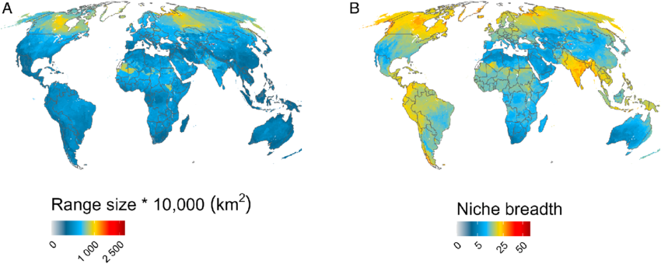
Functional Dimension
ResearchGate
- range of resources a species uses or
- variety of environmental conditions it can tolerate
Source: Araujo (1)
Notes:
To really understand the tropics, we have to look beyond just counting species. We have to look at the functional dimension: what species actually do, their physical traits, and how ecological jobs are distributed across the planet.
As you move from the equator to the poles, you don't just lose total species numbers; you change how functional roles are filled. In stable, warm tropical environments, organisms can evolve into extreme specialists. Because each species occupies a narrower ecological niche, which means it relies on a very specific set of environmental conditions, a limited diet, or a restricted habitat to survive, many more species can 'pack' into a single community without crowding each other out. You can see this pattern directly on the maps on the slide: Map B shows global niche breadth. The dark blue shading across the tropics highlights how equatorial species have extremely narrow ecological niches, which is what allows for tight niche packing. Map A shows geographic range sizes, which expand toward the poles (shaded yellow and red) because high-latitude organisms must evolve bigger environmental tolerances to survive severe conditions like weather. Climate and environmental energy shape functional roles directly. In cold polar oceans, this gradient flips for specific groups like seabirds and seals. Here, instead of packing into tight, specialized niches like they do in the tropics, species switch to eating the massive amounts of food available. This happens because cold, nutrient-rich water rises to the surface, creating a huge buffet for everyone. Simply put: the tropics are crowded with specialists, while the poles are all about huge numbers of generalists who can adapt to anything

Slide 10

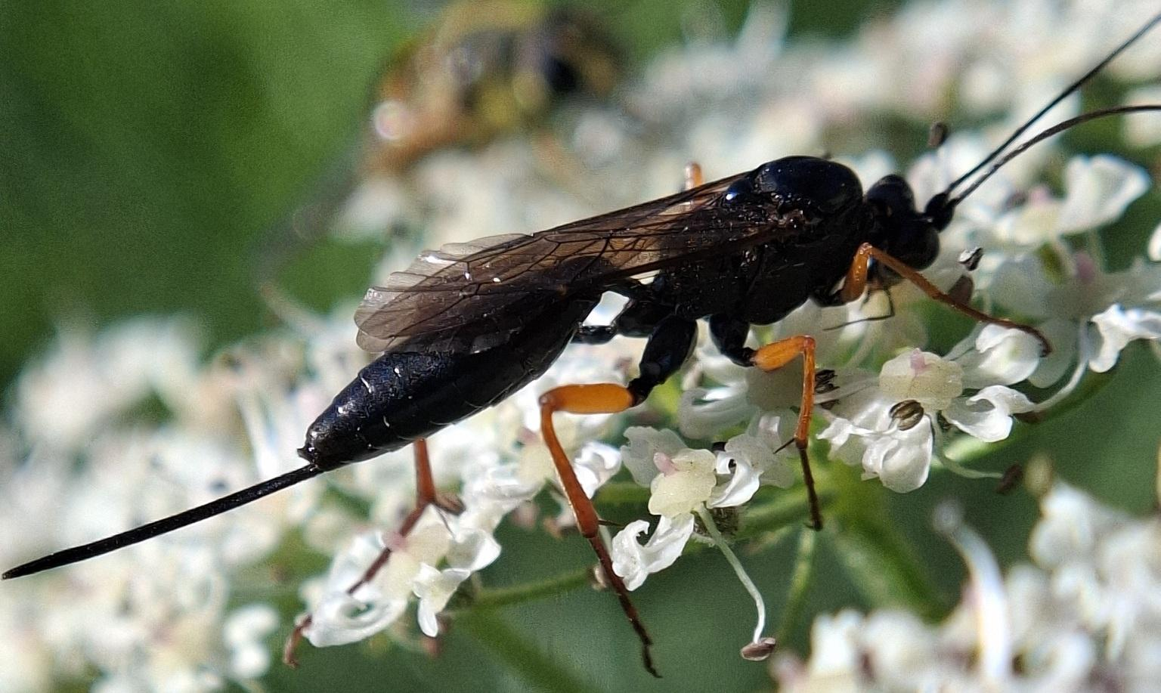
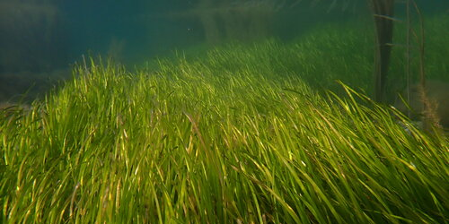
Taxonomic Exceptions
bug_report Parasitic Species
…don’t seem to follow LDG mechanics.
water_drop Aquatic Flora
…diversity peaks in temperate zones.
pets Secondary Marine Mammals & Birds
…revert the classical gradient and have higher diversity in polar and temperate zones.
© azure27014
© Nicolas Jouault
© Maik Mehlhose
Sources: Ng (11) Preisser (12), Poulin (13), Zhou (15)
Notes:
1. Parasitic species
The species richnesses of ecto- and endoparasites do not respond to latitude in a consistent fashion. This exception first discovered in parasitoidal Ichneumonidae. Further current studies indicate that ectoparasites in fish, birds, or mammals was unrelated to latitudinal variation.
Findings about Parasites can, however, be unreliable:
a) More existing surveys of parasite diversity in temperate areas than in the tropics.
b) Overall level of parasitological knowledge per host species is higher for temperate vertebrates than for tropical ones.
c) Taxonomic resolution achieved per survey is also generally higher for temperate vertebrates than for tropical ones.
→ Data from temperate and tropical regions are therefore not truly comparable at present, and it may be premature to attempt any large-scale test of the latitudinal diversity gradient hypothesis.
2. Aquatic Flora
With few exceptions, aquatic plants do not exhibit latitudinal gradients.
Plants that emerge from water, like plants in swaps, follow the gradient more like terrestrial plants. Submerged plants peak in diversity at around 45°.
3. Secondary marine birds and mammals
Those are taxa that have reverted to marine lifestyle after diverging from terrestrial ancestors.
These taxa tend to show a temperate or polar peak.
General Marine Biodiversity seems to peak around 15° and shows Equatorial Dip.
4. Generally
Newer findings also differentiate taxonomically and show that depending on the species, LGDs can be varying.

Slide 11
Applications
Sources: 12, 13
public Climate & Habitat
Prevention: Understanding patterns helps predict which ecosystems are most at risk.
verified_user Protection & Risks
Conservation: identify areas that need protection to prevent species loss.
Invasive species: predict where introduced species might spread.
auto_graph Prediction Models
Future biodiversity: models predict how species distributions and biodiversity patterns may change.
Astroecology: predicting alien life and ecosystems on other planets.
Source: Brodie (2), European Commission (5)
Notes:
Understanding the LDG and species distribution patterns has several practical uses.
First, for climate and habitat. As temperatures rise, species may move to higher latitudes or elevations to find suitable conditions. Habitat loss can also reduce the space and resources they need. Understanding these patterns helps us predict which ecosystems are most at risk.
Second, for protection and risks. Biodiversity patterns help scientists identify areas with many species that need protection. They can also help predict where invasive species might spread and threaten native ecosystems.
Third, predicting future biodiversity. Scientists use models and environmental data to predict where species might live in the future. This helps with conservation planning and assessing the environmental impacts of new developments.
Also it can be used in, astroecology. Where these ideas can help scientists understand how ecosystems might work on other planets.

Slide 12
Guiding Question
Why does biodiversity peak in the tropics and fall toward the poles, and does that hold for every dimension?
Functional
Counting jobs
Phylogenetic
Measure historic relationships
Taxonomic
Counting species

Slide 13
Sources
Araújo MS, Costa-Pereira R. (2013). Latitudinal gradients in intraspecific ecological diversity. Biology Letters 2013 Dec 11;9(6). <https://pmc.ncbi.nlm.nih.gov/articles/PMC3871364/>
Brodie, J. F., & Mannion, P. D. (2023). The hierarchy of factors predicting the latitudinal diversity gradient. Trends in Ecology & Evolution, 38(1), 15–23.
Chao, A., et al. (2021). Measuring temporal change in alpha diversity: A framework integrating taxonomic, phylogenetic and functional diversity and the iNEXT.3D standardization. Methods in Ecology and Evolution, vol. 12, pp. 1926–1940. <https://doi.org/10.1111/2041-210X.13682>
Chao, A., et al. (2014). “Unifying Species Diversity, Phylogenetic Diversity, Functional Diversity, and Related Similarity and Differentiation Measures Through Hill Numbers.” Annual Review of Ecology Evolution and Systematics, vol. 45, no. 1, Oct. 2014, pp. 297–324. <https://www.researchgate.net/publication/280760350_Unifying_Species_Diversity_Phylogenetic_Diversity_Functional_Diversity_and_Related_Similarity_and_Differentiation_Measures_Through_Hill_Numbers>
EBSCO: Biogeography (on-line) [cit.08.10.2026], available at: <https://www.ebsco.com/research-starters/geography-and-cartography/biogeography/>
European Commission (2013). Guidance on integrating climate change and biodiversity into environmental impact assessment. <https://op.europa.eu/en/publication-detail/-/publication/3ed0e578-7f24-4073-81c9-f279c6d4b3cf>
German Centre for Integrative Biodiversity Research: Macroeceology (on-line) [cit.08.10.2026], available at: <https://www.idiv.de/research/core-research-groups/biodiversity-in-the-anthropocene/research-theme-macroecology/>
IPBES (2026). IPBES Reports (on-line) [cit.19.10.2026], available at: <www.ipbes.dk/en/reports-and-knowledge/ipbes-reports>
Nature Index: Latitudinal Gradients in Biodiversity and Biotic Interactions (on-line) [cit.19.10.2026], available at: <https://www.nature.com/nature-index/topics/l4/latitudinal-gradients-in-biodiversity-and-biotic-interactions>
Mittelbach GG, et al. (2007). Evolution and the latitudinal diversity gradient: speciation, extinction and biogeography. Ecological Letters. Apr;10(4):315-31.
Ng, E.Y.X., et al. (2025). Ecological and Evolutionary Factors Shape the Extra-Tropical Latitudinal Species Diversity Peak in Procellariiform Seabirds. Journal of Biogeography, vol. 52, nº 12. <https://doi.org/10.1111/jbi.70088>
Preisser, W. (2019). Latitudinal gradients of parasite richness: a review and new insights from helminths of cricetid rodents. Ecography, vol. 42, nº 7, pp. 1315-1330.
Poulin, R. (2010). Latitudinal gradients in parasite diversity: bridging the gap between temperate and tropical areas. Neotropical Helminthology, vol. 4, nº 2, pp. 169-177.
Willig, M. R., Kaufman, D. M., & Stevens, R. D. (2003). Latitudinal gradients of biodiversity: pattern, process, scale, and synthesis. Annual review of ecology, evolution, and systematics, 34(1), 273-309.
Zhou, Y., et al. (2022). Latitudinal gradients of α- and β-diversity of aquatic plant communities across eastern China: Helophytes and hydrophytes show inconsistent patterns.
Gemini Notebook (AI) and Claude have been used in this presentation for visualization, data organization and research purposes.

Slide 14
Images
Slide 3
  Classical LDP Map created with Gemini Notebook
  LDG Research Map: https://www.researchgate.net/figure/EXAMPLE-OF-A-SPECIES-RICHNESS-MAP-FOR-ALL-SPECIES-ON-THE-IUCN-RED-LIST-OF-THREATENED_fig5_259849426
Slide 6
  Illustrating Richness vs Evenness: https://old-ib.bioninja.com.au/options/option-c-ecology-and-conser/c4-conservation-of-biodiver/biodiversity.html
Slide 9
  Niche Breadth: https://www.researchgate.net/figure/Global-map-of-species-A-geographic-range-size-and-B-niche-breadth-Range-size-maps_fig1_397514936
Slide 10
  Ichneumonid Wasp: https://www.inaturalist.org/observations/389590023
  Zostera marina: https://www.inaturalist.org/photos/407128059
  Delphinapterus leucas: https://www.inaturalist.org/photos/561462803

Slide 15






Names & Contributions
Alexandra Garner
Methodology Challenges
Methods & Measurement
Historical Data Functional Dimension
Lorin Sevinç
Visuals and Animations
Historical Data
Maik Mehlhose
Presentation Structure
Macroecology & Biogeography
Biodiversity Dimensions
Taxonomical Exceptions
Natalie Poláčková
What is LDG?
Biodiversity Concepts
Why does LDG occur?
Applications
Simon Musel
Introduction macroecology and
biogeography
Methods of measurement
Group Work Approach
Learning Material
Visuals
Vinayak Kumar Naik
Why does LDG occur?
Marine Equatorial Biodiversity Dip

Slide 16
Time for Questions
Thanks for your attention!

